Slide 1


Descriptive Statistics: Measures of Dispersion & Skewness
Notes:
In this presentation we will describe various measures of dispersion and skewness and discuss their implementation in R

Slide 2
Measures of Dispersion
Measures of dispersion are descriptive statistics that describe how similar a set of scores are to each other
The more similar the scores are to each other, the lower the measure of dispersion will be
The less similar the scores are to each other, the higher the measure of dispersion will be
In general, the more spread out a distribution is, the larger the measure of dispersion will be
Notes:
A measure of Dispersion is a summary statistic that represents the amount of variability in a dataset. In other words, how spread out are the values? While a measure of central tendency describes the typical value, measures of variability define how far away the data points tend to fall from the center. We talk about variability in the context of a distribution of values. A low dispersion indicates that the data points tend to be clustered tightly around the center while high dispersion implies that they tend to fall further away.
In statistics, variability, dispersion, and spread are synonyms that denote the width of the distribution.

Slide 3
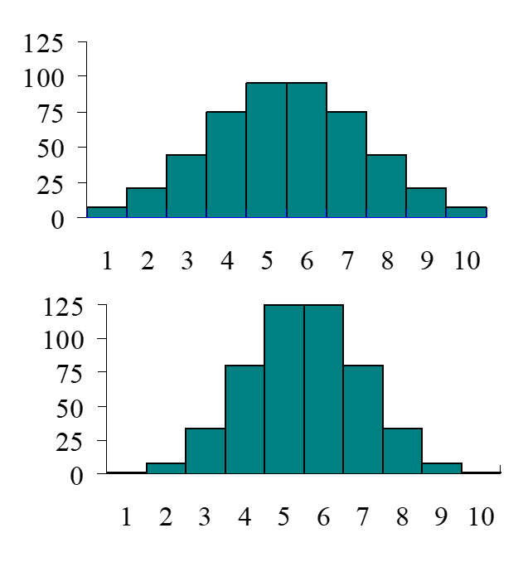
Quiz: Test your knowledge
Which of the distributions of scores has the larger dispersion?
A) Top graph B) Bottom graph C) Dispersion is equal in both cases
“A” is the answer

Slide 4
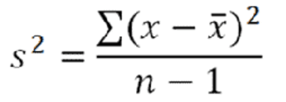
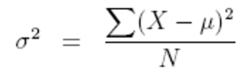
Measures of Dispersion: Range and Variance
Range: The spread, or the distance, between the lowest and highest values of a variable. i.e. range(a)=max(a)-min(a)
Variance: The expectation of the squared deviation of a variable from its mean. Sample variance is defined as:
while the population variance is defined in terms of the population mean μ and population size N:
Notes:
Just as there are multiple measures of central tendency, there are several measures of variability. Let’s start with the range because it is the most straightforward measure of variability to calculate and very easy to understand.
The range of a dataset is the difference between the largest and smallest values in that dataset. While the range is easy to understand, it is based on only the two most extreme values in the dataset, and therefore can be easily affected by outliers.
Additionally, the size of dataset affects the range. In general, you are less likely to observe extreme values. However, as you increase the sample size, you have more opportunities to obtain these extreme values. Consequently, when you draw random samples from the same population, the range tends to increase as the sample size increases.
Variance is another measure of dispersion which is defined as the average squared difference of the values from the mean. Unlike the range, the variance includes all values in the calculation by comparing each value to the mean. To calculate the variance, you calculate a set of squared differences between the data points and the mean, then you sum them, and then divide by the number of observations.
There are two formulas for the variance depending on whether you are calculating the variance for an entire population or using a sample to estimate the population variance. If the variance is calculated for samples, instead of dividing by the number of observations, you would need to dived by the number of observations minus one.

Slide 5
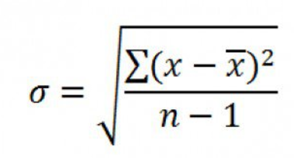
Measures of Dispersion: Standard Division
Standard Division (σ ): The square root of the variance. It is expressed in the original units of measurement and represents the average amount of dispersion in a sample
Notes:
Because the calculations of variance use the squared differences, the variance is in squared units rather the original units of the data. While higher values of the variance indicate greater variability, there is no intuitive interpretation for specific values.
Standard deviation, is another measure of dispersion which is calculated as the square root of the variance. When the values in a dataset are grouped closer together, you have a smaller standard deviation.
Conveniently, the standard deviation uses the original units of the data, which makes interpretation easier. As a result, the standard deviation is the most widely used measure of variability.

Slide 6
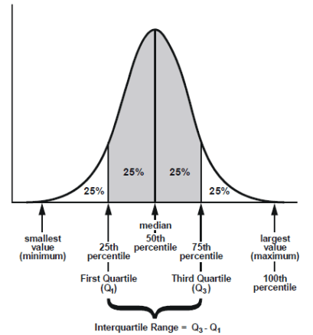
Interquartile range (IQR)
A quartile is the value that marks one of the divisions that breaks a series of values into four equal parts. The median is a quartile and divides the values in half.
The interquartile range is the distance or range between the 25th percentile and the 75th percentile.
Notes:
Interquartile range or IQR for short is another measure of dispersion. A quartile is the value that marks one of the divisions that breaks a series of values into four equal parts. The median is a quartile and divides the data into 2 parts.
The interquartile range is the middle half of the data that is in between the upper and lower quartiles. In other words, the interquartile range includes the 50% of data points that falls in the second and third quartiles as shown in the figure.

Slide 7
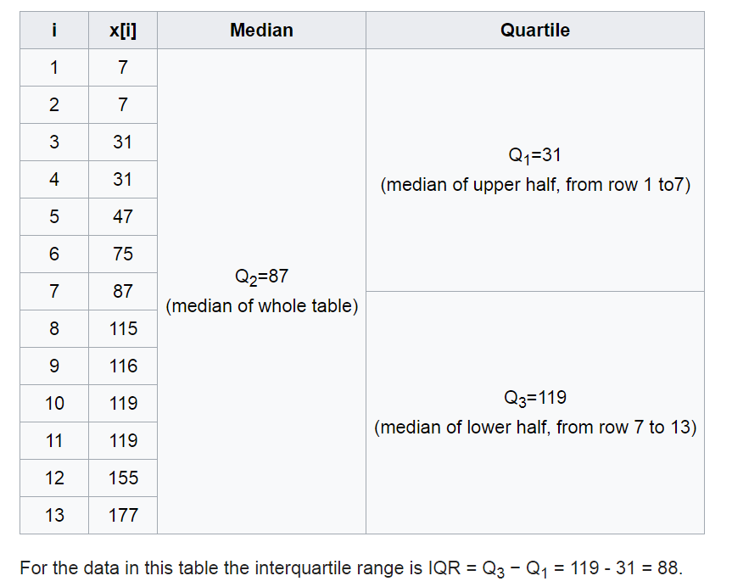
Interquartile Range (IQR) : Example
Notes:
Here is an example of a calculation of IQR. In this case we have 13 data points, which are all sorted ascendingly. As we can see, the median point of the data is 87, which is marked as Q2. Q1 can be considered as the median of the upper half of the data, which is 31. Similarly, the Q3 can be considered as the median of the lower half of the data, which is 119. IQR is the difference between Q3 and Q1, which in this case is 119 minus 31, which is equal to 88.

Slide 8
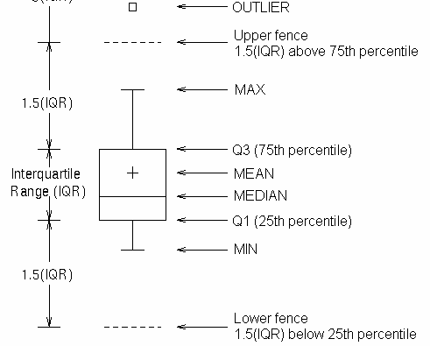
Visualizing Dispersion: Boxplot
Boxplot shows groups of numerical data through their quartiles.
Outliers may be plotted as individual points that are 1.5 IQR above the Q3 or 1.5 IQR below Q1.
Notes:
Box plot is an excellent tool for visualization of this version of the data points. The box plot shows the group of numerical data through their quartiles, so in this case you can see the minimum, the maximum, the median, as well as the first and third quartile of the data. All this may also be plotted as individual data points that are one and a half IQR above the Q3, or one and a half IQR below the Q1.

Slide 9
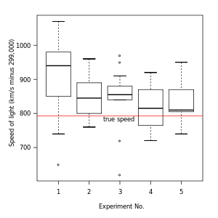
Visualizing Dispersion: Boxplot
Notes:
Here is an example of a box plot. In this graph a number of experiments have been preformed to measure the speed of light. Each experiment contains a set of measurements. As we can see the dispersion of the data or the variability of the data was highest in the first experiment, and it was lowest in the third experiment. However, there were some outliers observed in the third experiment and in the first experiment. The true speed of light is indicated by the red line in the figure.

Slide 10
Quiz: Test your knowledge
Imagine that you have a dataset with some outliers at extreme ends. Which of the following dispersion measures is most affected by these extreme outliers?
Range
Variance
Standard Deviation
IQR
The answer is A: Remember range is only defined by the two extreme points in the dataset

Slide 11
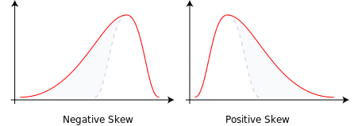
Measures of Skewness
Skewness is a measure of the asymmetry of the probability distribution of a real-valued random variable about its mean. The skewness value can be positive or negative.
Notes:
A further characterization of the data includes skewness. Skewness is a measure of symmetry, or more precisely, the lack of symmetry. One informal but useful way of checking the skewness of a distribution is to look at the density curve. A distribution is symmetric if it looks the same to the left and right of the center point.Here, the density curve in the left Figure has a longer tail to the left than to the right. In this case, we can say the data is skewed to the left or negatively skewed. On the other hand, the distribution in the right graph can be considered as positively skewed. As we observed before, in most cases when the data is negatively skewed, the mean of the distribution is smaller than the median. This is because the mean is more likely to be affected by extreme values than the median. The case is the other way round for positively skewed data where mean is normally greater than the median.

Slide 12
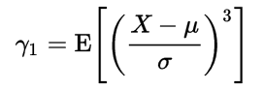
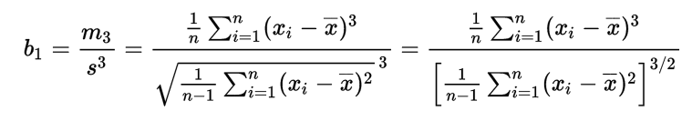
Measures of Skewness
Population Skewness is can be expressed as:
Sample Skewness can be estimated as:
If the distribution is symmetric around mean the expected sum of X- μ will be zero
Notes:
The measure of skewness defined here is called the Skewness coefficient which is also referred to as the Pearson moment coefficient of skewness. This measure provides information about the amount and direction of the departure from symmetry. Its value can be positive or negative. The higher the absolute value of the skewness measure, the more asymmetric is the distribution. The skewness measure of symmetric distributions is close to zero.
To help put the definition of skewness in context, we first calculate the 3rd central moment of a random variable X as the expected value, or mean, of the 3rd power of the deviation of the variable from its mean. That is to take the mean from all elements and take that to power 3 and calculate the mean of the results. The ratio of the third central moment to the cube of the standard deviation is called the coefficient of skewness and is denoted by gamma_1 for the population or b1 for the sample.
Again note that the operator E in here represents the expected value which is the same mean.

Slide 13
Implementation in R
# We will use 'cars' dataframe which is available in R distributions #The data give the speed of cars ('speed') and the distances taken to stop ('dist'). #Let's calculate the range of speed values in the dataframe Range_Speed=max(cars$speed)-min(cars$speed) Range_Speed
## [1] 21
# Lets calculate the variance and standard deviation of distance Variance_distance=var(cars$dist) print(paste("Distance variance is", Variance_distance))
## [1] "Distance variance is 664.060816326531"
SD_distance=sd(cars$dist) print(paste("Distance standard deviation is", SD_distance))
## [1] "Distance standard deviation is 25.7693774920259"
SD_distance^2
## [1] 664.0608
Notes:
Let’s consider an example here. We will use the “cars” data frame which is available in R base. The data gives the speed of cars with the variable “speed” and the distance taken to stop with the variable “dist.” Let’s calculate the range of speed values in the data frame. Here we can say Range_Speed=max(cars$speed) which we are basically explicitly telling R that we are looking for the variable “speed” in the cars data set minus the min(cars$speed). So essentially, we are basically calculating the delta between the maximum and minimum of the speed. Once we have the variable calculated, if we just basically write the name of the variable, the value of the variable will be printed to us, which in this case is 21. Let’s move on and calculate the variance and the standard deviation of the distance. We can define a new variable called “variable_distance” which is equal to var(cars$dist). So we can see that the function for calculation of variance is called “var” and we can basically print the value here as well. So we can use the paste function to calculate the vectors after converting them to characters. In this case the variable of variance distance will be converted to character and will be printed together with the starting string. In this case we can see that the output reads as distance variance is and then the value of the variance, which in this case is 664.06. Ao let’s calculate the standard deviation of the distance, which the function for that is SD. We can, again, print the standard deviation value the same way as we printed the variance value, and we can see that the standard deviation is 25.76. So if you calculate the square of the standard deviation, you can see that the standard deviation power 2 is exactly equal to the variance that we have. So SD_distance^2 is equal to 664.06 which is exactly the variance value we calculated earlier.

Slide 14
Implementation in R
# Let's look at the quartile of speed quantile(cars$speed)
## 0% 25% 50% 75% 100% ## 4 12 15 19 25
print(paste("Speed Median is", median(cars$speed)))
## [1] "Speed Median is 15"
print(paste("Speed IQR is", IQR(cars$speed)))
## [1] "Speed IQR is 7"
Notes:
Let’s continue and look at the quartiles of the speed variable. We can use the function quantile; in this case we can see the minimum, the maximum, the median, and the first and third quartiles of the speed variable printed below. So it’s obvious that the minimum speed is 4, the maximum speed is 25, the first quartile is 12, the third quartile is 19, and the median is 15. We can double check this by using the function median as well, so in this case we have printed the median value, which is again 15. And now, if you remember, IQR was the distance between the first and the third quartile, which in this case is 19 minus 12. We can use the function IQR in R to calculate that and if we print that value we can see that the IQR of the speed is 7, which is expected from the quartile values we have seen.

Slide 15
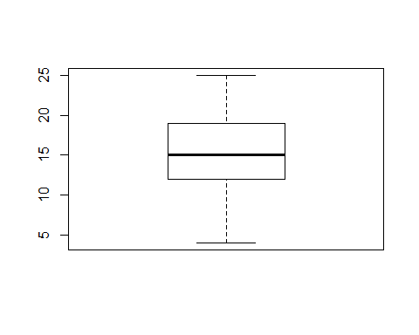
Implementation in R
# Let's construct the boxplot of speed boxplot(cars$speed)
# Let's calculate the skewness coefficient of speed Skewness_speed=mean(((cars$speed-mean(cars$speed))/sd(cars$speed))^3) Skewness_speed
## [1] -0.1105533
Notes:
Let’s continue and construct the box plot of the speed variable. The function here is boxplot, and as you can see the boxplot shows the minimum, and the maximum, and the median, and the first and third quartile of the data as we have already seen. So the minimum in this case is 4, the maximum is 25, and the median is 15. Let’s move on and calculate the skewness coefficient of the speed variable. If you recall, the skewness coefficient was calculated as the ratio of the third central moment to the cube of the standard deviation. By writing the formula we can easily calculate the skewness of the speed as it is printed here as -0.11, which suggests that the data is not hugely skewed in this case because the value is close to 0.

Slide 16
Quiz: Test your knowledge
Imagine that you have some measurements where the mean of the distribution is much larger than its median value. Which statement is correct?
A) The data is skewed towards right and the skewness factor is negative
B) The data is skewed towards right and the skewness factor is positive
C) The data is skewed towards left and the skewness factor is negative
D) The data is skewed towards left and the skewness factor is positive
Answer: B. If mean is much larger that the median it means that the data is skewed towards right hand side which also means that the skewness is positive.

